Slide 1
Developing Filters to Trick Facial Recognition Software with GANs
Jialiang Liang, Chris Quion, Cole Weinhauer

Slide 2
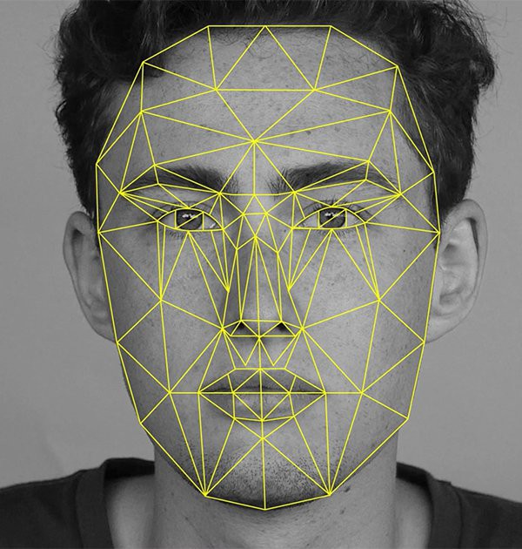
Introduction
A system that creates filters that can be overlaid over human faces that cause facial recognition systems to be unable to detect the face.
generative adversarial network (GAN)

Slide 3
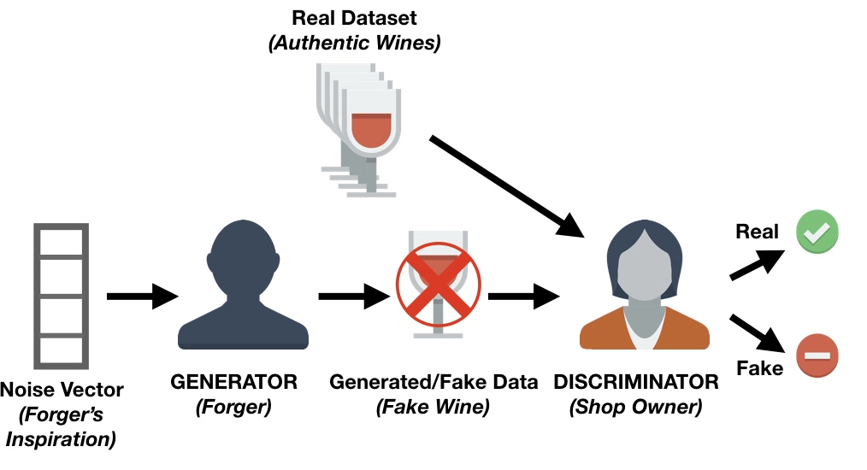
GAN
2 deep neural net systems:
Discriminator: Read the combination of the face data and filter, after that, it will generate an output of the probability of this combination is a face or not
Generator: It receives the face data and puts a filter on the original data.

Slide 4
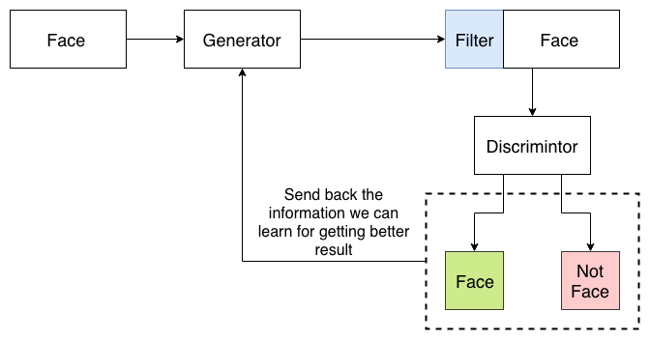
System Architecture

Slide 5

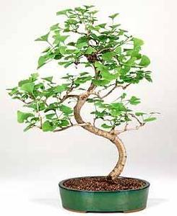
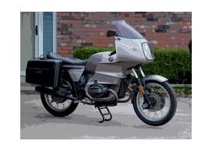

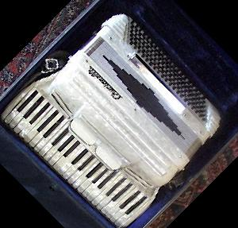
Datasets
Labeled faces in the wild - Deep funneling set
13,000 Different and regular human faces
Subset of 101 classified objects dataset
Random Objects with different classification
Number of images for each classification range from 40 to 800, and most classifications have above 50 images

Slide 6
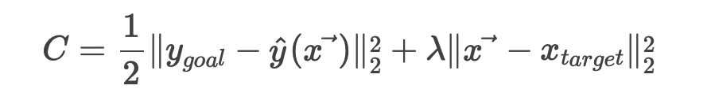
Approach
Random noise with strong classification as “Not a Face”
Label “Not a Face”
Filter overlaid on Face Image
Face Image

Slide 7
Approach
Left Term
Minimizing this will make the neural network output y_goal when given ⃗x.
Right Term
Minimizing the second term will try to force our adversarial image x to be as close as possible to x_target as possible

Slide 8
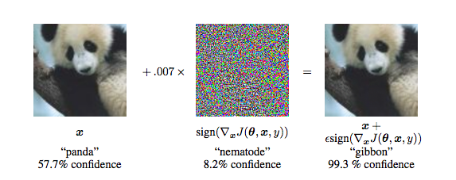
Approach
Essentially, this is what we are trying to do!
Notes:
Adversarial examples are inputs to a neural network that result in an incorrect output from the network. It’s probably best to show an example. You can start with an image of a panda on the left which some network thinks with 57.7% confidence is a “panda.” The panda category is also the category with the highest confidence out of all the categories, so the network concludes that the object in the image is a panda. But then by adding a very small amount of carefully constructed noise you can get an image that looks exactly the same to a human, but that the network thinks with 99.3% confidence is a “gibbon.” Pretty crazy stuff!

Slide 9

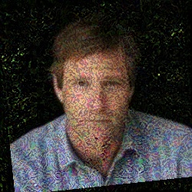
Results

Slide 10
Limitations
Discriminator possibly not properly trained
was providing the wrong class for the un-adversarial, but consistent
but was consistently fooled too! (the predicted class would change to targeted class)
Hard to get discriminator and generator synchronized

Slide 11
References
https://ml.berkeley.edu/blog/2018/01/10/adversarial-examples/
https://skymind.ai/wiki/generative-adversarial-network-gan
https://arxiv.org/abs/1406.2661

Slide 12
Any Questions?

